Slide 1
Simulazione di prodotto Industry 4.0

Slide 2
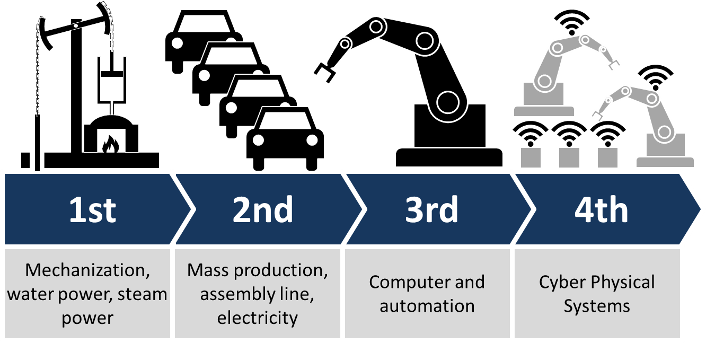
Industry 4.0
cyber-physical systems
Internet of things
cloud computing
cognitive computing
Notes:
https://en.wikipedia.org/wiki/Industry_4.0

Slide 3
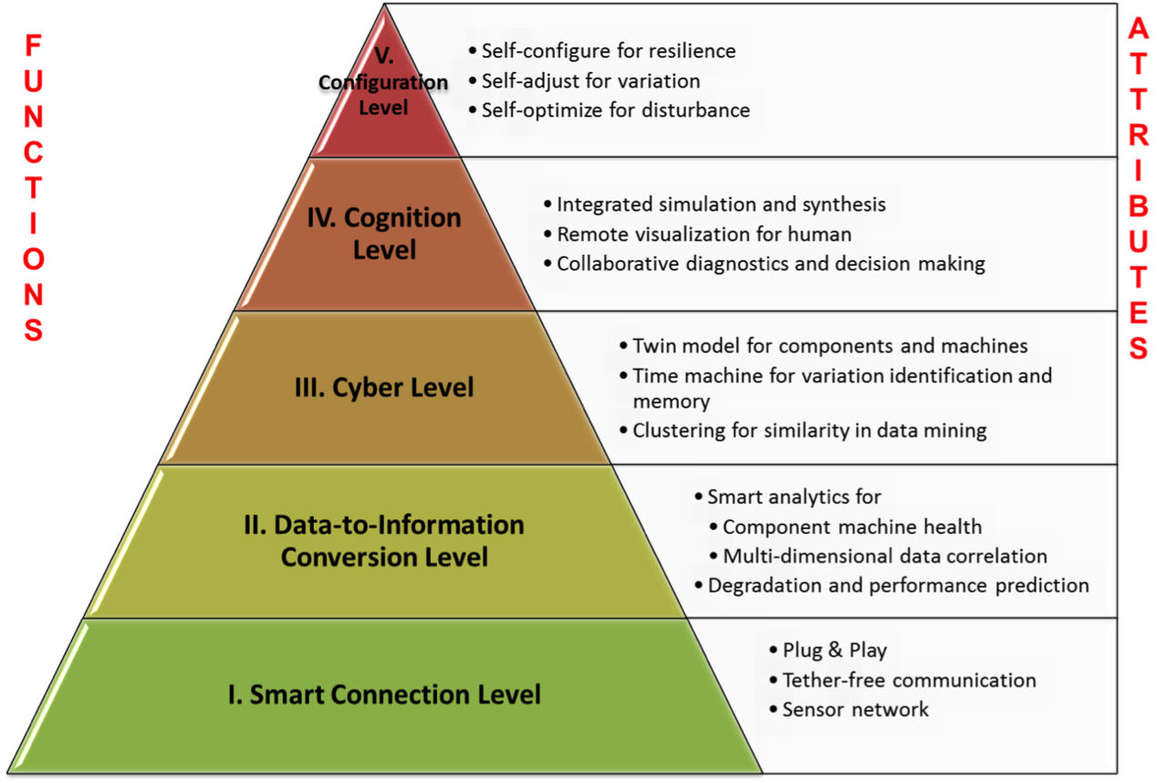
Cyber-physical system
5C model
Notes:
https://en.wikipedia.org/wiki/Cyber-physical_system
https://en.wikipedia.org/wiki/Digital_twin

Slide 4
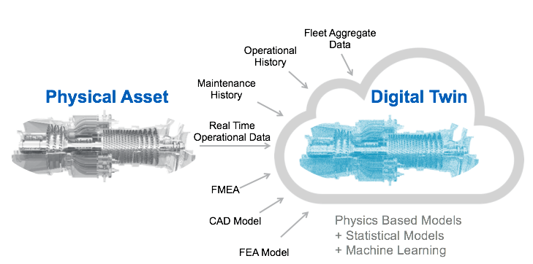
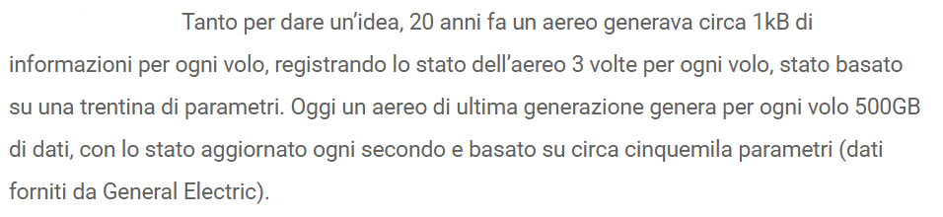
Digital Twin
3D printing
Augmented Reality
Time machine
Notes:
https://en.wikipedia.org/wiki/Digital_twin https://www.agendadigitale.eu/industry-4-0/industry-4-0-modello-digital-twin-migliora-sviluppo-prodotti/

